Slide 1



KONGU ENGINEERING COLLEGE
PERUNDURAI ERODE-638060
DEPARTMENT OF COMPUTER APPLICATIONS
MINI PROJECT I
TITLE: GRAD CHAT
TEAM MEMBERS: PRANITHA P (24MCR076)
SAKTHIVEL R(24MCR086)
SAM ANDERSON Y(24MCR087)
SUPERVISOR
Ms. T. KALPANA
ASSISTANT PROFESSOR
MCA DEPARTMENT

Slide 2
ABSTRACT
This project is a mobile application designed to bridge the gap between college juniors and seniors, fostering mentorship and community engagement.
Junior Profile
Tailored for new joiners and introverted students seeking guidance, this section allows juniors to connect with seniors, ask questions, and gain insights on topics such as placement strategies, study tips, and event management.
Senior Profile
Experienced students (seniors and super seniors) can share knowledge, post resources, announce placement opportunities, and organize junior skill development events.
User-Friendly Features
The app's intuitive UI helps juniors select specific mentors based on categories like placement
volunteers, super seniors, event coordinators, and department or university toppers.
24-Dec-2024
1

Slide 3






SYSTEM REQUIREMENTS
SOFTWARE REQUIREMENTS :
Frontend: React Native
Backend: Node.js with Express.js (Framework)
Database: Firebase (for real-time database capabilities)
HARDWARE REQURMENTS :
RAM: 8 GB
Processor: Intel i5
Graphics Card: NVIDIA GeForce GTX 1660
24-Dec-2024
2

Slide 4





DISADVANTAGES OF EXISTING SYSTEM
No Dedicated Mentorship
Platform
Unorganized Mentorship Opportunities
Time-Consuming and Inefficient
Lack of Anonymity for Juniors
Difficulty in Tracking Progress
24-Dec-2024
3

Slide 5







ADVANTAGES OF PROPOSED SYSTEM
Real-Time Updates for Opportunities and Events
Private and public chat option for personalized and group queries.
Explore Career Paths Through Detailed Senior Profiles
24/7 access to mentorship and
resources
24/7 Chatbot Support for Instant Assistance
Efficient mentor selection via categorized profiles. (e.g.,, academic toppers, placement and event coordinators).
24-Dec-2024
4

Slide 6
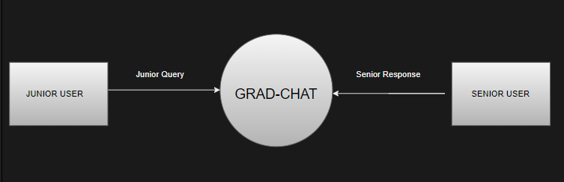
DATA FLOW DIAGRAM
LEVEL 0 :
24-Dec-2024
5

Slide 7
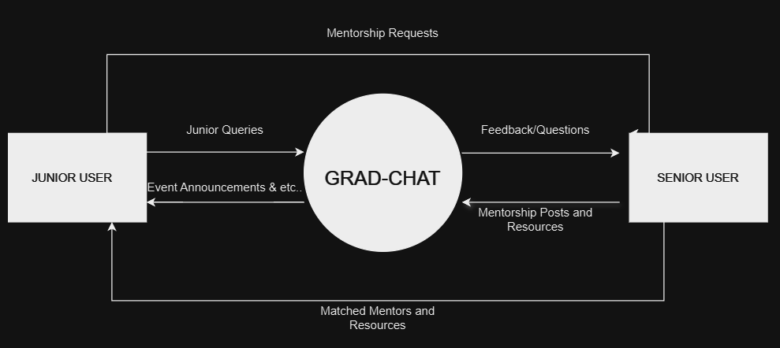
DATA FLOW DIAGRAM
LEVEL 1 :
24-Dec-2024
6

Slide 8
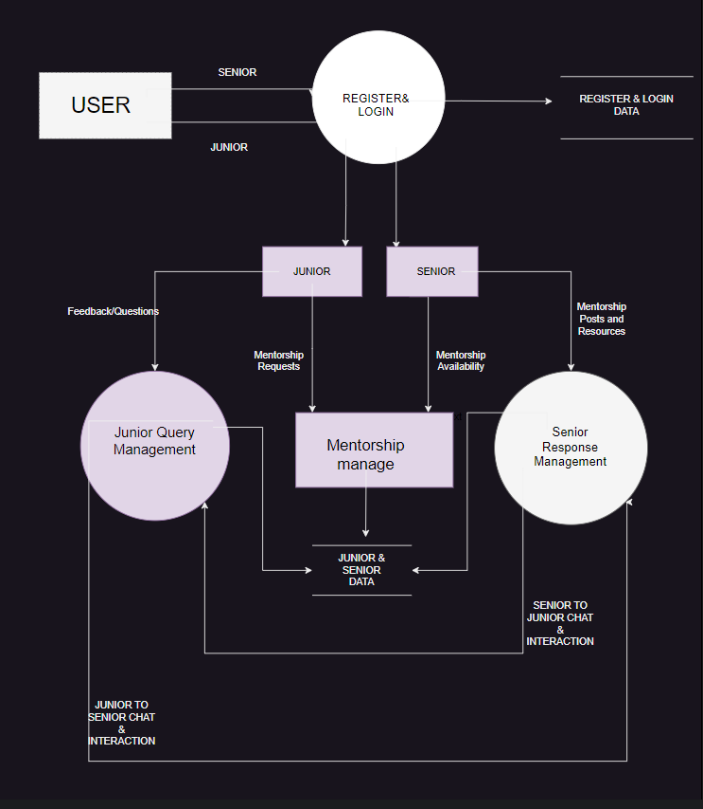
DATA FLOW DIAGRAM
LEVEL 2 :
24-Dec-2024
7

Slide 9
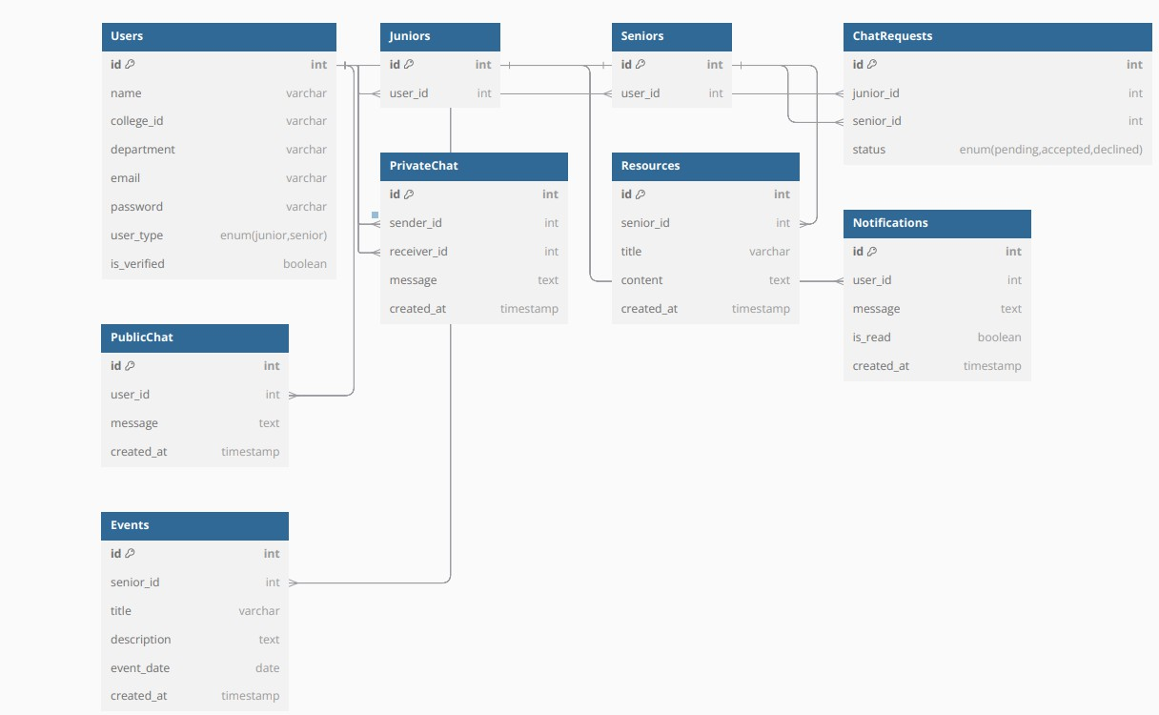
CLASS DIAGRAM
24-Dec-2024
8

Slide 10
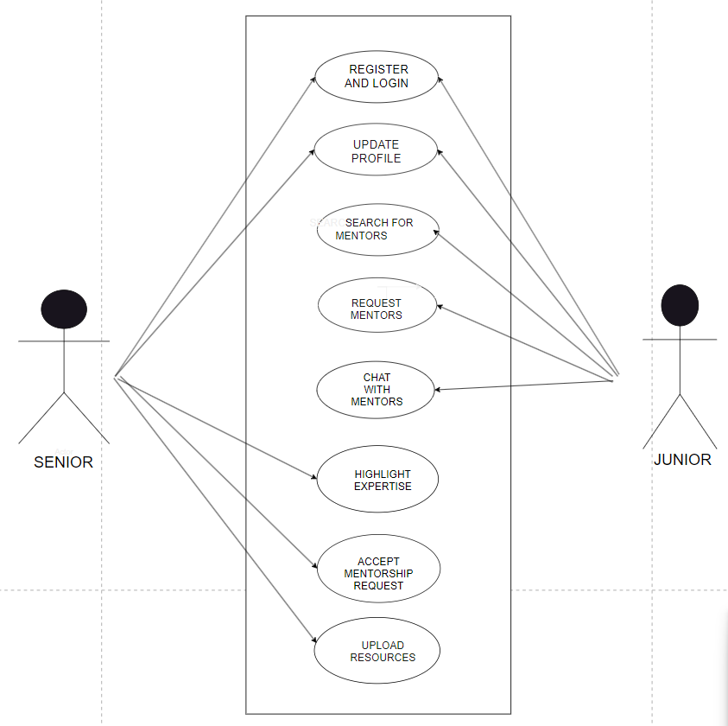
USE CASE DIAGRAM
24-Dec-2024
9

Slide 11
MODULE DESCRIPTION
1. User Profiles Module
Junior Profile
Senior Profile
2. Mentorship Matching Module
Placement and Event Coordinators
Placed Super Seniors
Department/University Toppers
3. Chat System Module
Public Chat
Private Chat
4. Chatbot Integration Module
5. Integration Module
LinkedIn, GitHub Integration
6. Alerts Module
Achievements & Updates Module
24-Dec-2024
10

Slide 12
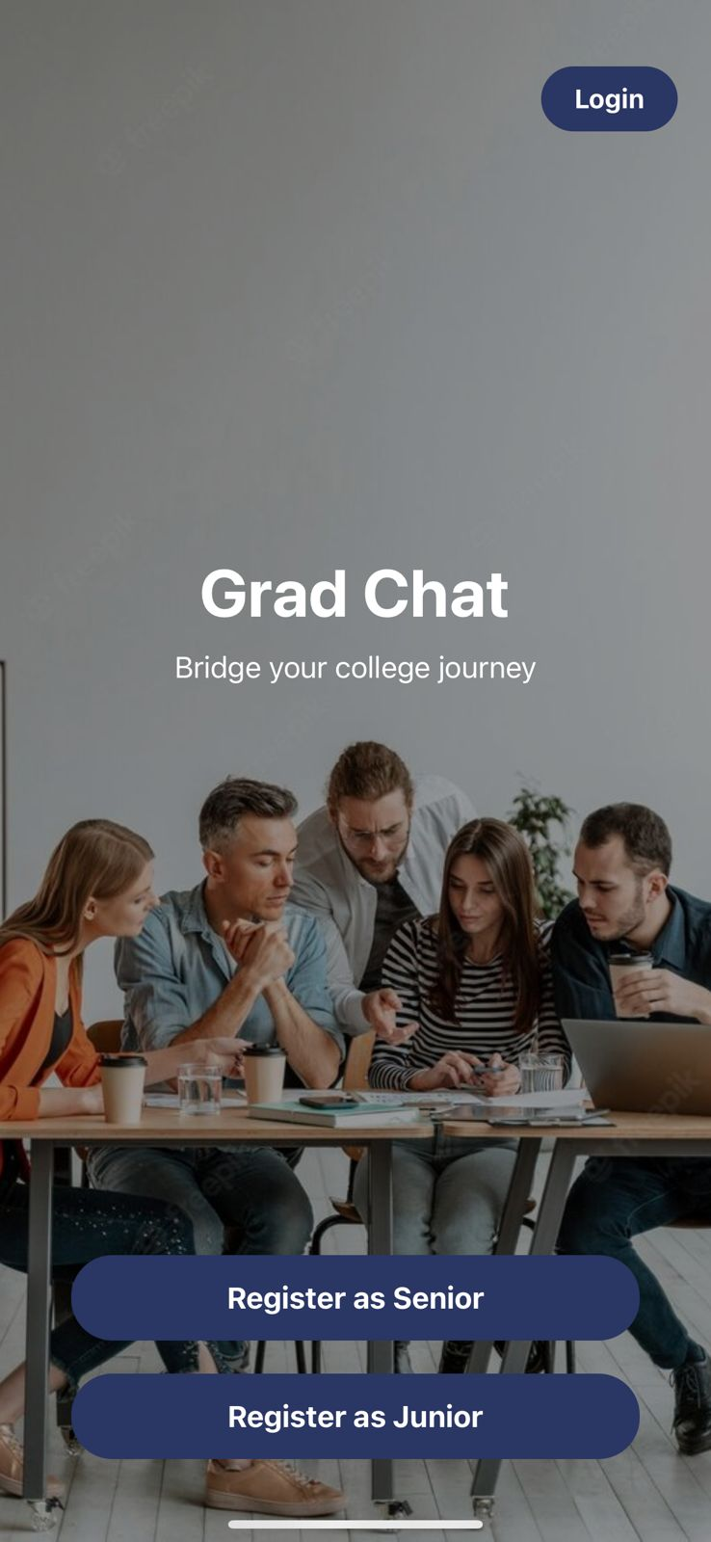
SAMPLE SCREENSHOTS
24-Dec-2024
11

Slide 13
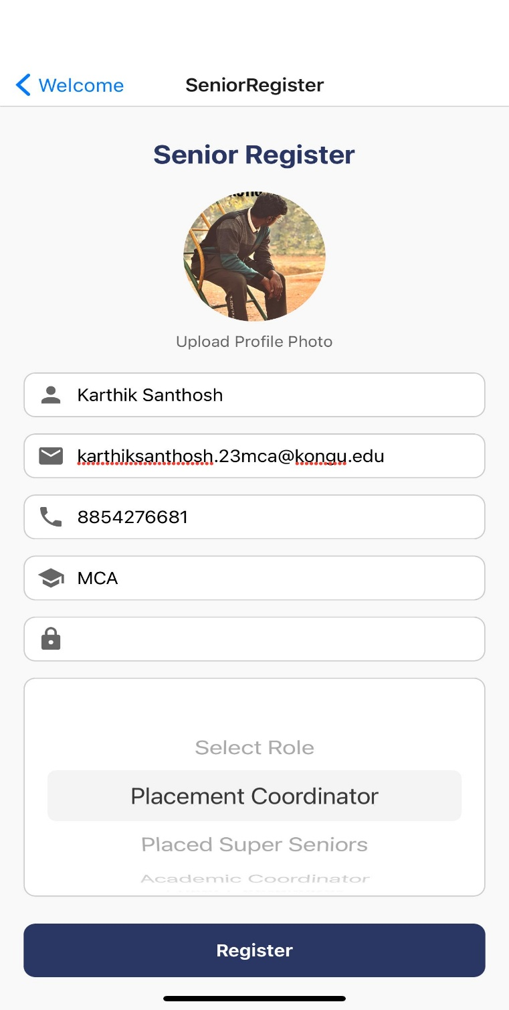
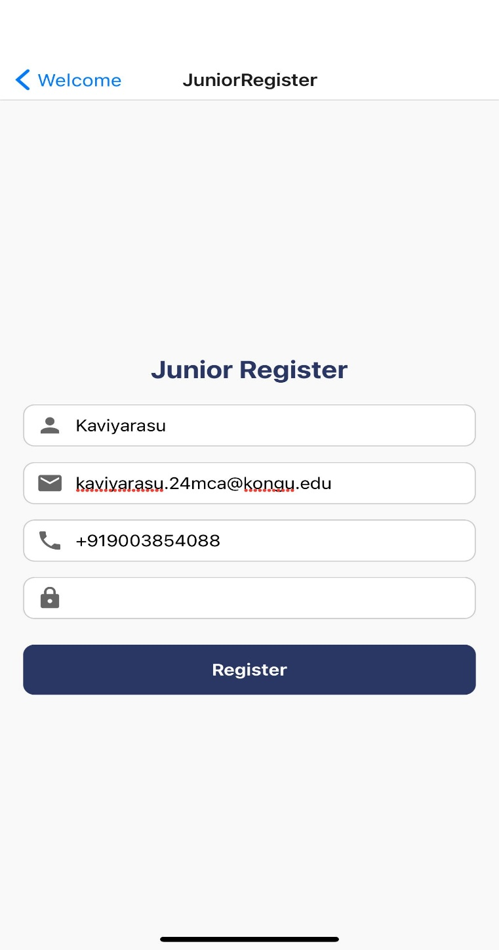
24-Dec-2024
12

Slide 14
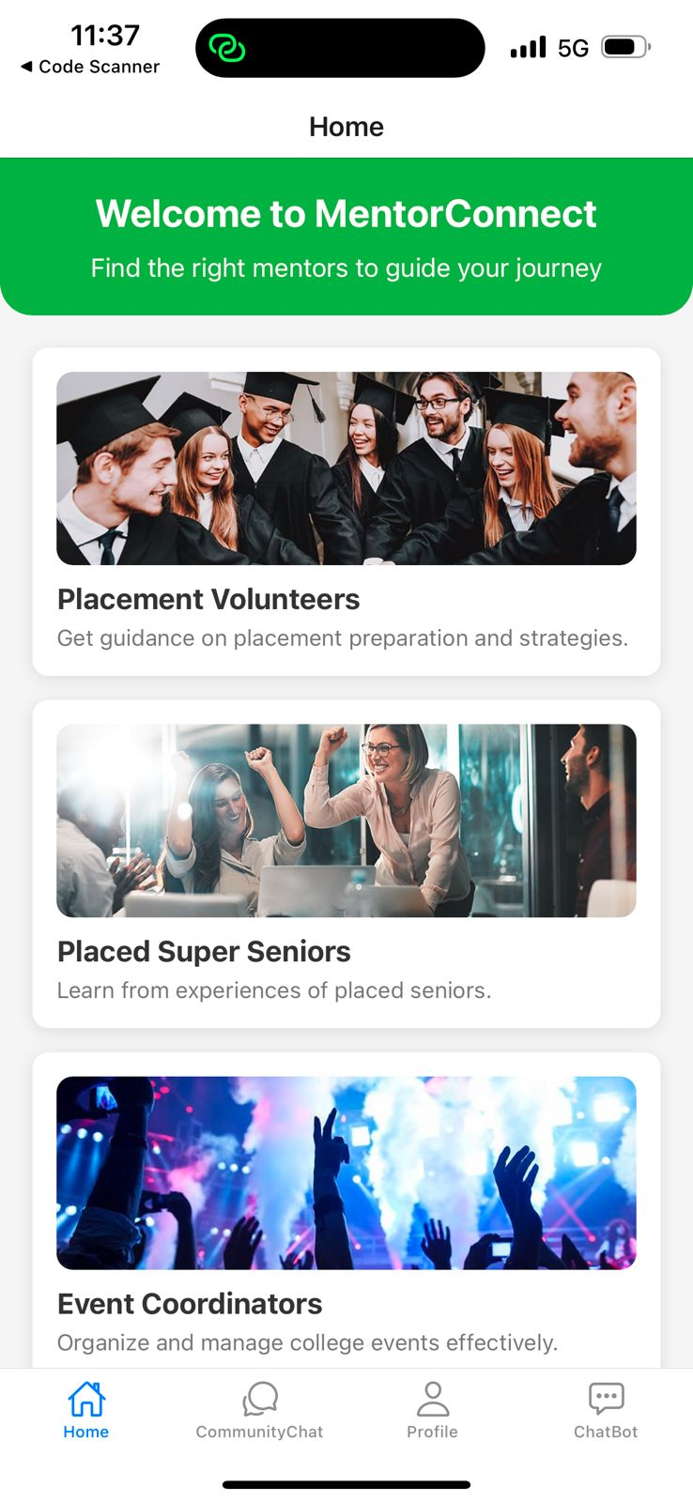
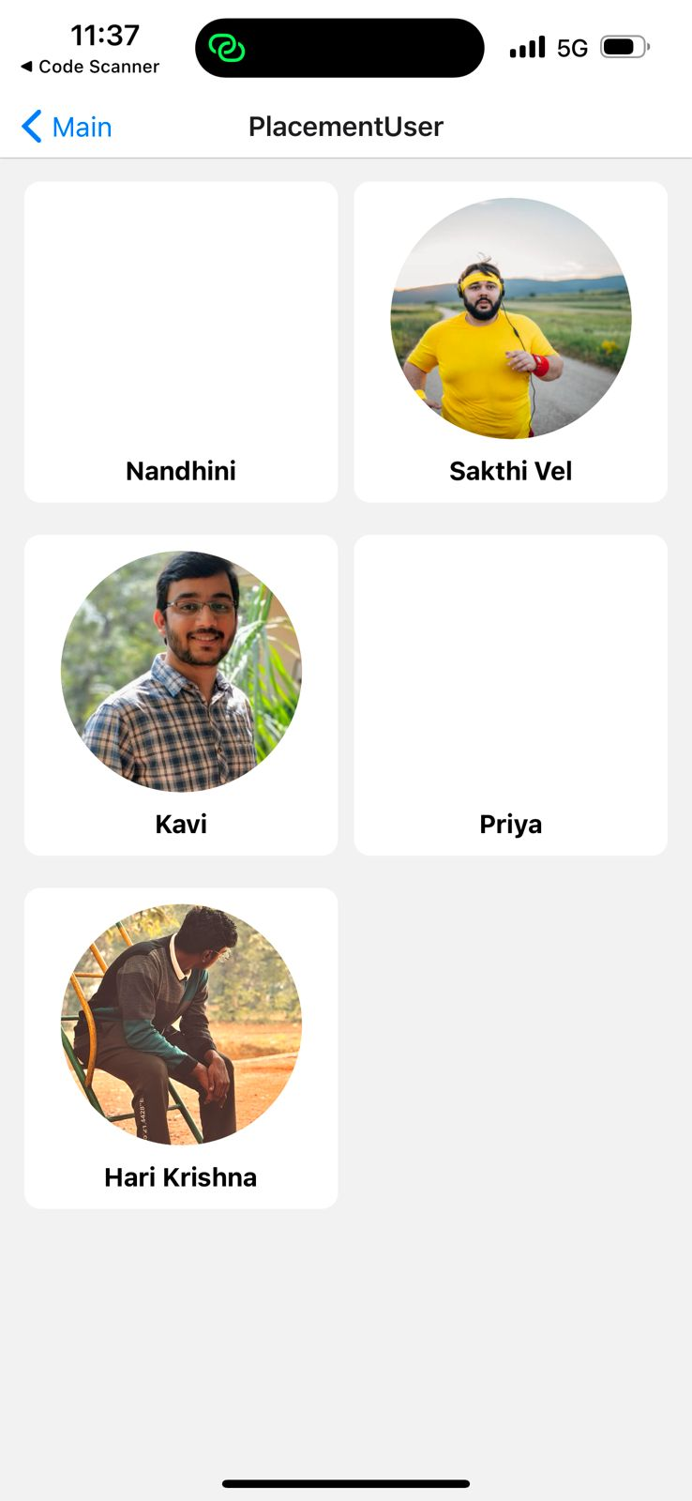
24-Dec-2024
13

Slide 15
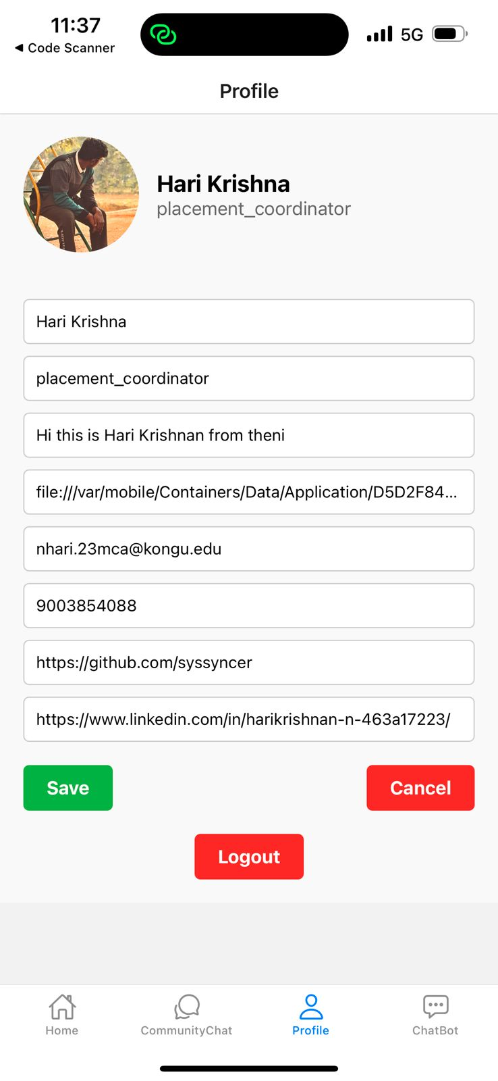
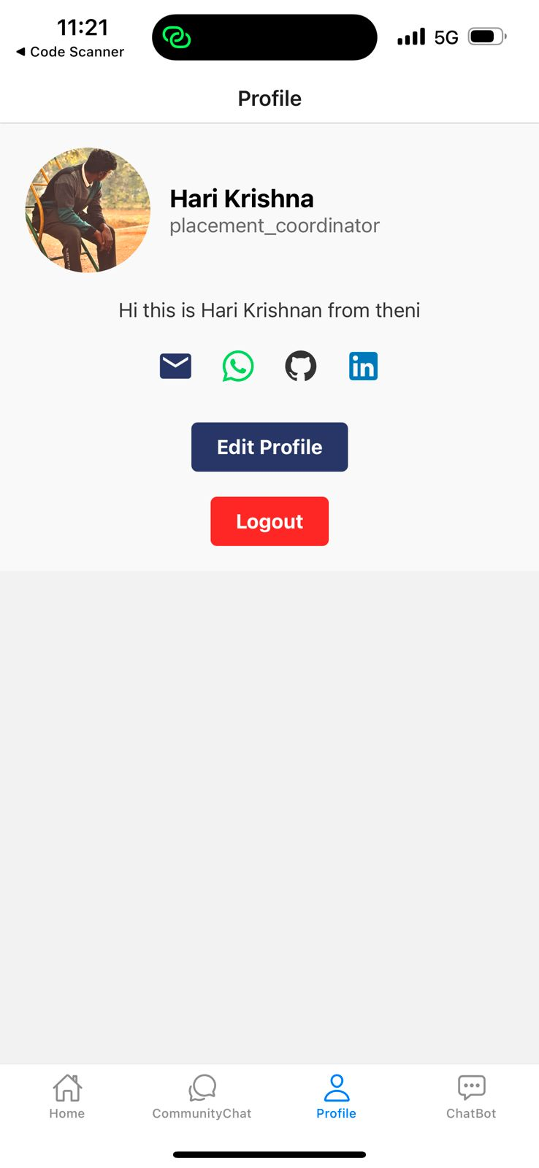
24-Dec-2024
14

Slide 16
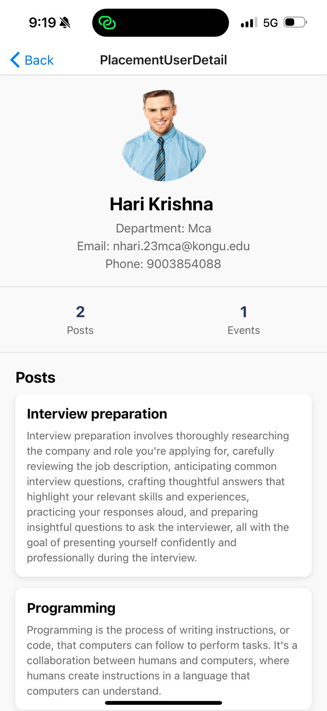
24-Dec-2024
15

Slide 17
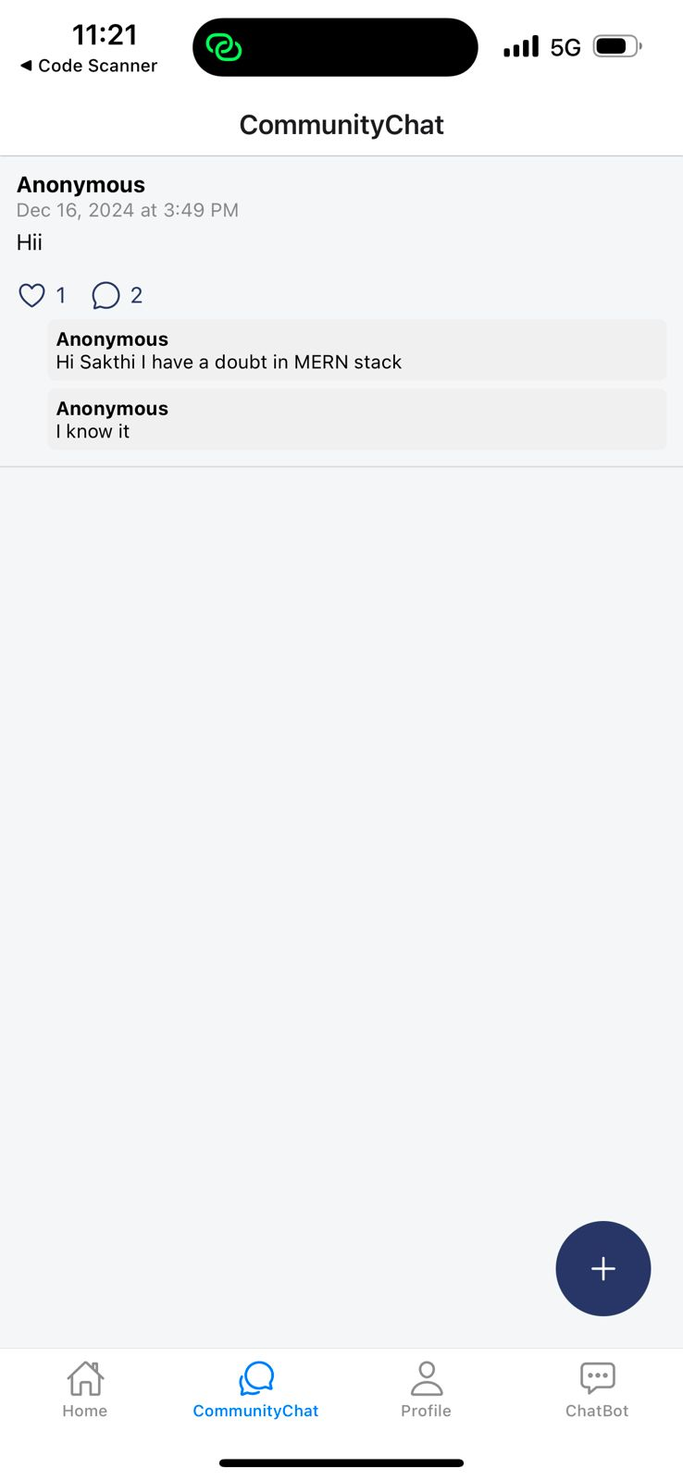
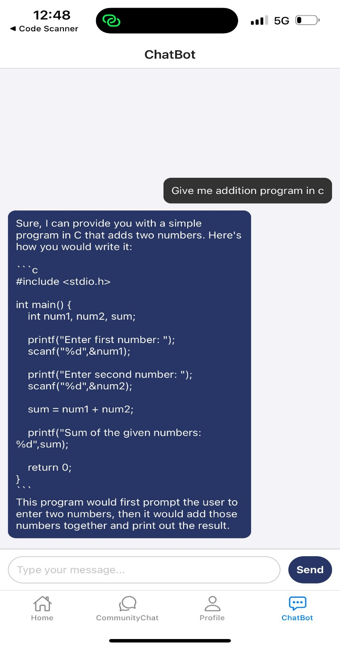
24-Dec-2024
16

Slide 18
THANK YOU!

